Slide 1
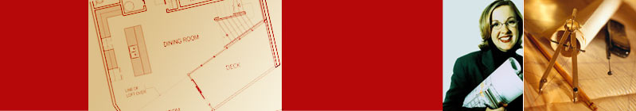

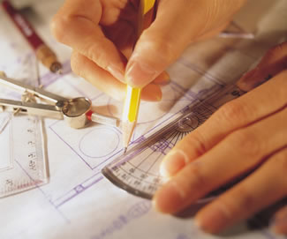
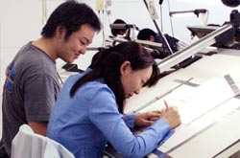
Chapter 7
Dimensioning

Slide 2
TOPICS
Introduction
Dimensioning components
Dimensioning object’ s features
Placement of dimensions.

Slide 3

Introduction

Slide 4
ENGINEERING DESIGN
PROCESS
RESULT
TRANSFERRED
INFORMATION
Design
a part
Sketches
of ideas
Multiview
Drawing
Create
drawings
Shape
1. Size, Location
Dimensioning
2. Non-graphic information
Manufacture

Slide 5
DEFINITION
Dimensioning is the process of specifying part’ s
information by using of figures, symbols and notes.
This information are such as:
1. Sizes and locations of features
2. Material’s type
3. Number required
4. Kind of surface finish
5. Manufacturing process
6. Size and geometric tolerances
This course

Slide 6

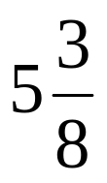
DIMENSIONING SYSTEM
1. Metric system : ISO and JIS standards
This
course
Examples
32, 32.5, 32.55, 0.5 (not .5) etc.
2. Decimal-inch system
Examples
0.25 (not .25), 5.375 etc.
3. Fractional-inch system
Examples
,
etc.

Slide 7
Dimensioning
Components

Slide 8
DIMENSIONING COMPONENTS
Extension lines
Dimension lines
(with arrowheads)
Drawn with
4H pencil
Leader lines
Dimension figures
Notes :
- local note
- general note
Lettered with
2H pencil.

Slide 9
EXTENSION LINES
indicate the location on the object’s features that are dimensioned.

Slide 10
DIMENSION LINES
indicate the direction and extent of a dimension, and inscribe dimension figures.
10
27
123º
13
43

Slide 11
LEADER LINES
indicate details of the feature with a local note.
10
27
10 Drill, 2 Holes
R16
123º
13
43

Slide 12
Recommended
Practices

Slide 13
EXTENSION LINES
Leave a visible gap (≈ 1 mm) from a view and start drawing an extension line.
Extend the lines beyond the (last) dimension line 1-2 mm.
COMMON MISTAKE
Visible gap

Slide 14
EXTENSION LINES
Do not break the lines as they cross object lines.
COMMON MISTAKE
Continuous

Slide 15
DIMENSION LINES
Dimension lines should not be spaced too close
to each other and to the view.
Leave a space at least
2 times of a letter height.
16
35
11
34
Leave a space at least
1 time of a letter height.

Slide 16
DIMENSION FIGURES
The height of figures is suggested to be 2.5~3 mm.
Place the numbers at about 1 mm above dimension
line and between extension lines.
COMMON MISTAKE
34
11
11
34

Slide 17
DIMENSION FIGURES
When there is not enough space for figure or
arrows, put it outside either of the extension lines.
Not enough space
for figures
Not enough space
for arrows
16.25
1
1
1
16.25
or

Slide 18
DIMENSION FIGURES : UNITS
The JIS and ISO standards adopt the unit of
Length dimension in millimeters without
specifying a unit symbol “mm”.
Angular dimension in degree with a symbol “º”
place behind the figures (and if necessary
minutes and seconds may be used together).

Slide 19
DIMENSION FIGURES : ORIENTATION
1. Aligned method
The dimension figures are placed so that they are readable from the bottom and right side of the drawing.
2. Unidirectional method
The dimension figures are placed so that they can be read from the bottom of the drawing.
Do not use both system on the same drawing or on the same series of drawing (JIS Z8317)

Slide 20
EXAMPLE : Dimension of length using aligned method.
30
30
30
30
30
30
30
30

Slide 21
EXAMPLE : Dimension of length using unidirectional method.
30
30
30
30
30
30
30
30

Slide 22
EXAMPLE : Dimension of angle using aligned method.
45º
45º
45º
45º
45º
45º
45º
45º

Slide 23
EXAMPLE : Dimension of angle using unidirectional method.
45º
45º
45º
45º
45º
45º
45º
45º

Slide 24
LOCAL NOTES
Place the notes near to the feature which they
apply, and should be placed outside the view.
Always read horizontally.
COMMON MISTAKE
10 Drill
10 Drill
≈ 10mm
10 Drill
Too far

Slide 25
Dimensioning
Practices

Slide 26
THE BASIC CONCEPT
Dimensioning is accomplished by adding size and location information necessary to manufacture
the object.
This information have to be
Clear
Complete
Facilitate the
- manufacturing method
measurement method

Slide 27
EXAMPLE
L
L
Designed
part
L
S
L
S
To manufacture this part
we need to know…
S
1. Width, depth and
thickness of the part.
S
2. Diameter and depth
of the hole.
“S” denotes size dimension.
“L” denotes location dimension.
3. Location of the holes.

Slide 28
ANGLE
To dimension an angle use circular dimension
line having the center at the vertex of the angle.
COMMON MISTAKE

Slide 29
ARC
Arcs are dimensioned by giving the radius, in the
views in which their true shapes appear.
The letter “R” is always lettered before the figures
to emphasize that this dimension is radius of an
arc.
R 200
R 200
or

Slide 30
ARC
The dimension figure and the arrowhead should
be inside the arc, where there is sufficient space.
Sufficient space
for both.
Sufficient space
for arrowhead only.
Insufficient space
for both.
Move figure outside
Move both figure
and arrow outside
R 62.5
R 200
R 6.5
R 58.5

Slide 31
ARC
Leader line must be radial and inclined with
an angle between 30 ~ 60 degs to the horizontal.
COMMON MISTAKE
R62.5
R62.5
R62.5
60º
R62.5
R62.5
R62.5
30º

Slide 32
ARC
Use the foreshortened radial dimension line,
when arc’ s center locates outside the sheet or
interfere with other views.
Method 1
Method 2
Drawing sheet

Slide 33
FILLETS AND ROUNDS
Give the radius of a typical fillet only by using a
local note.
If all fillets and rounds are uniform in size,
dimension may be omitted, but it is necessary to
add the note “ All fillets and round are Rxx. ”
R6.5
R12
NOTE:
All fillets and round are R6.5
NOTE:
All fillets and round are R6.5
unless otherwise specified.
Drawing sheet

Slide 34
CURVE
The curve constructed from two or more arcs,
requires the dimensions of radii and center’s
location.
COMMON MISTAKE
Tangent point

Slide 35
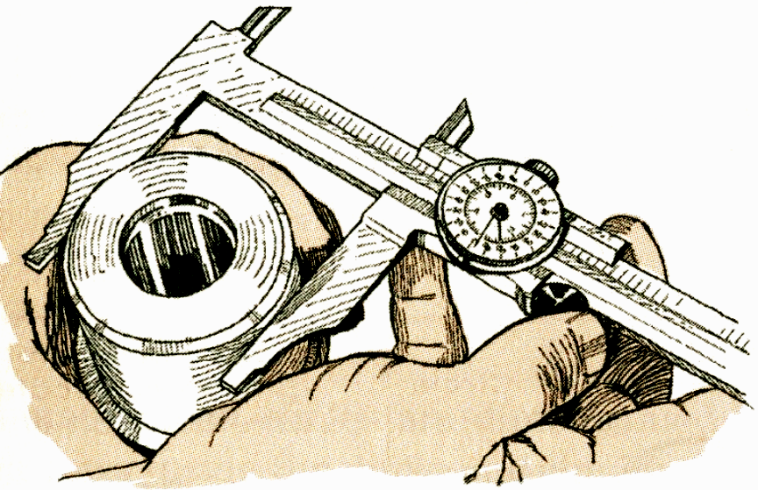
CYLINDER
Size dimensions are diameter and length.
Location dimension must be located from its
center lines and should be given in circular view.
Measurement
method

Slide 36
CYLINDER
Diameter should be given in a longitudinal view with the symbol “φ ” placed before the figures.
φ 100
φ 70

Slide 37
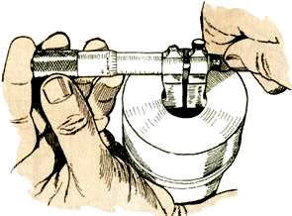
HOLES
Size dimensions are diameter and depth.
Location dimension must be located from its
center lines and should be given in circular view.
Measurement
method

Slide 38
HOLES : SMALL SIZE
Use leader line and local note to specify diameter
and hole’s depth in the circular view.
1) Through thickness hole
φ xx
φ xx Thru.
xx Drill.
xx Drill, Thru.
or
or
or

Slide 39

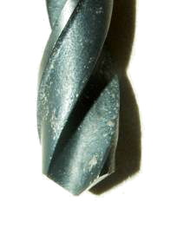
HOLES : SMALL SIZE
Use leader line and local note to specify diameter
and hole’s depth in the circular view.
2) Blind hole
φ xx, yy Deep
xx Drill, yy Deep
or
Hole’s
depth

Slide 40
HOLES : LARGE SIZE
Use extension and dimension lines
Use diametral dimension line
Use leader line and note
φ xx

Slide 41
HOLES
COMMON MISTAKE
φ xx
φ xx
φ xx
Rxx
φ xx
φ xx

Slide 42
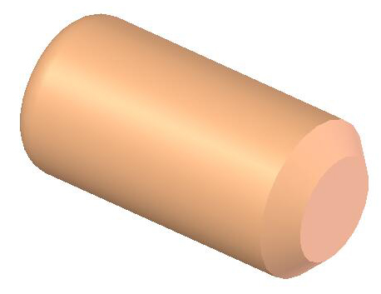
CHAMFER
Use leader line and note to indicate linear
distance and angle of the chamfer.
θ
S θ
S
For a 45º chamfer
or
CS
S S

Slide 43
ROUNDED-END SHAPES
Dimensioned according to the manufacturing
method used.
φ 12
R12
Center to Center Distance
21
5

Slide 44
ROUNDED-END SHAPES
Dimensioned according to the manufacturing
method used.
R12
12
21
Center to Center Distance
5

Slide 45
ROUNDED-END SHAPES
Dimensioned according to the manufacturing
method used.
R12
12
16
21

Slide 46
ROUNDED-END SHAPES
Dimensioned according to the manufacturing
method used.
R12
12
27
Tool cutting distance

Slide 47
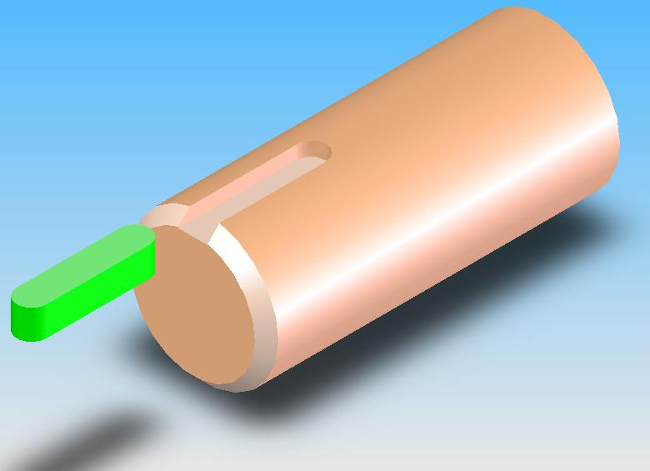
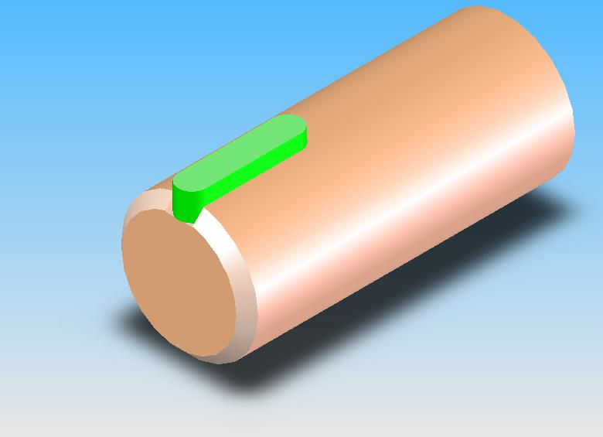
ROUNDED-END SHAPES
Dimensioned according to the standard sizes of
another part to be assembled or manufacturing
method used.
Key
(standard part)
25

Slide 48
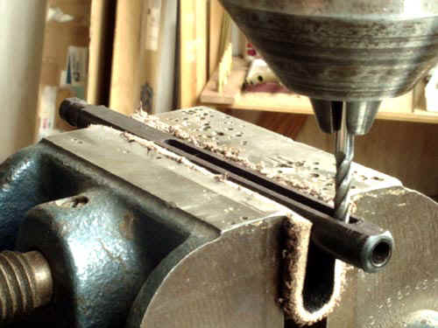
ROUNDED-END SHAPES
Dimensioned according to the standard sizes of
another part to be assembled or manufacturing
method used.
20

Slide 49
Placement of
Dimensions

Slide 50
RECOMMENDED PRACTICE
Extension lines, leader lines should not cross
dimension lines.
POOR
GOOD

Slide 51
RECOMMENDED PRACTICE
2. Extension lines should be drawn from the nearest
points to be dimensioned.
POOR
GOOD

Slide 52
RECOMMENDED PRACTICE
3. Extension lines of internal feature can cross visible
lines without leaving a gap at the intersection point.
WRONG
CORRECT

Slide 53
RECOMMENDED PRACTICE
4. Do not use object line, center line, and dimension
line as an extension lines.
POOR
GOOD

Slide 54
RECOMMENDED PRACTICE
5. Avoid dimensioning hidden lines.
POOR
GOOD

Slide 55
RECOMMENDED PRACTICE
6. Place dimensions outside the view, unless
placing them inside improve the clarity.
POOR
GOOD

Slide 56
RECOMMENDED PRACTICE
6. Place dimensions outside the view, unless
placing them inside improve the clarity.
JUST OK !!!
BETTER

Slide 57
RECOMMENDED PRACTICE
7. Apply the dimension to the view that clearly show
the shape or features of an object.
POOR
GOOD

Slide 58
RECOMMENDED PRACTICE
8. Dimension lines should be lined up and grouped
together as much as possible.
POOR
GOOD

Slide 59
RECOMMENDED PRACTICE
9. Do not repeat a dimension.
POOR
GOOD

